Slide 1
SPAMMER DETECTION AND FAKE USER IDENTIFICATION ON
SOCIAL NETWORKS
GUIDE :
Dr.L.Srikanth
(ASSOCIATE PROFESSOR-CSE)
Team:-
A.Naga Akshita(18-5K7)
N .Nandini(18-5K5)
D.Amulya(18-5M4)
V. Navya Sree(18-5L1)

Slide 2
ABSTRACT:
Nowadays Usage of Social Networks increasing rapidly. A user interacts with social sites such as Twitter, Facebook, Instagram, Mails , etc.….
Leading social network sites have turned into target platforms for the spammers to disperse a huge amount of irrelevant information.
Therefore it allows an unreasonable amount of spam. Fake users send undesired tweets to users to promote services or websites that not only affect legitimate users but also disrupt resource consumption.
Moreover, the possibility of expanding invalid information to users through fake identities has increased that results in the unrolling of harmful content.
Recently, the detection of spammers and identification of fake users on Twitter has become a common area.

Slide 3
Here we perform a techniques used for detecting spammers on Twitter.
Twitter spam detection approaches is presented on the techniques based on their ability to detect:
(I) Fake content
(ii) Spam based on URL
(iii) Fake users

Slide 4
IMPLEMENTATION:
Here we are developing the webpage for detecting fake user ,spam base URL, fake content.
It is an online social network between user and admin (client-server technology).

Slide 5
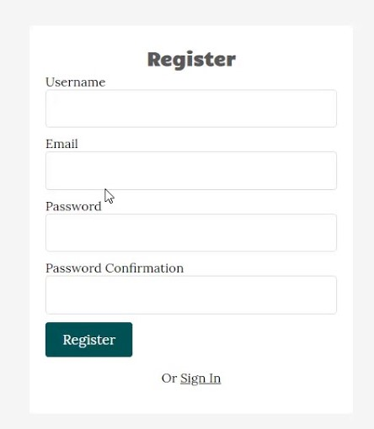

If a user want to LOGIN in a web page ,user has to REGISTER into the webpage.

Slide 6


Admin should authorize the user registration so that user can access the webpage

Slide 7


If any user try to login without any registration and admin authorization , the user is accessing the twitter platform will be identified as a spam/fake user.

Slide 8

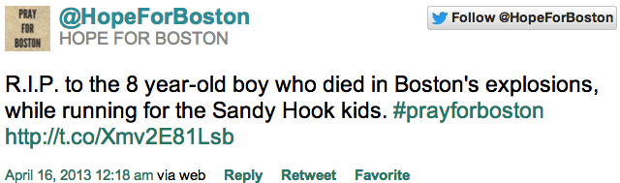

Now when the user try to tweet by providing any fake data and post on the twitter platform ,the admin will recognize the fake user or data.

Slide 9
SOFTWARE REQUIREMENTS
OPERATING SYSTEM :- Windows 10
LANGUAGE :- Java7 ,J2EE
WEB DEVELOPMENT :- Html, CSS, JavaScript
IDE :- Net beans
WEB SERVER :- Tomcat
DATABASE :- Mysql
JAVA VERSION :- Jdk 7u2

Slide 10
HARDWARE REQUIREMENTS
RAM :- 8GB
HARD DISK :- 119 GB
PROCESSOR :- Intel core

Slide 11
CONCLUSION
- We performed a review of techniques used for detecting spammers on Twitter. In addition, we also presented a taxonomy of Twitter spam detection approaches and categorized them as fake content detection, URL based spam detection, spam detection in trending topics, and fake user detection techniques.
- False news identification on social media networks is an issue that needs to be explored because of the serious consequences of such news at individual as well as collective level.

